Slide 1
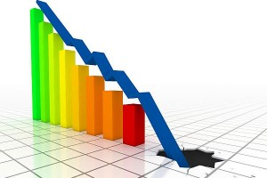
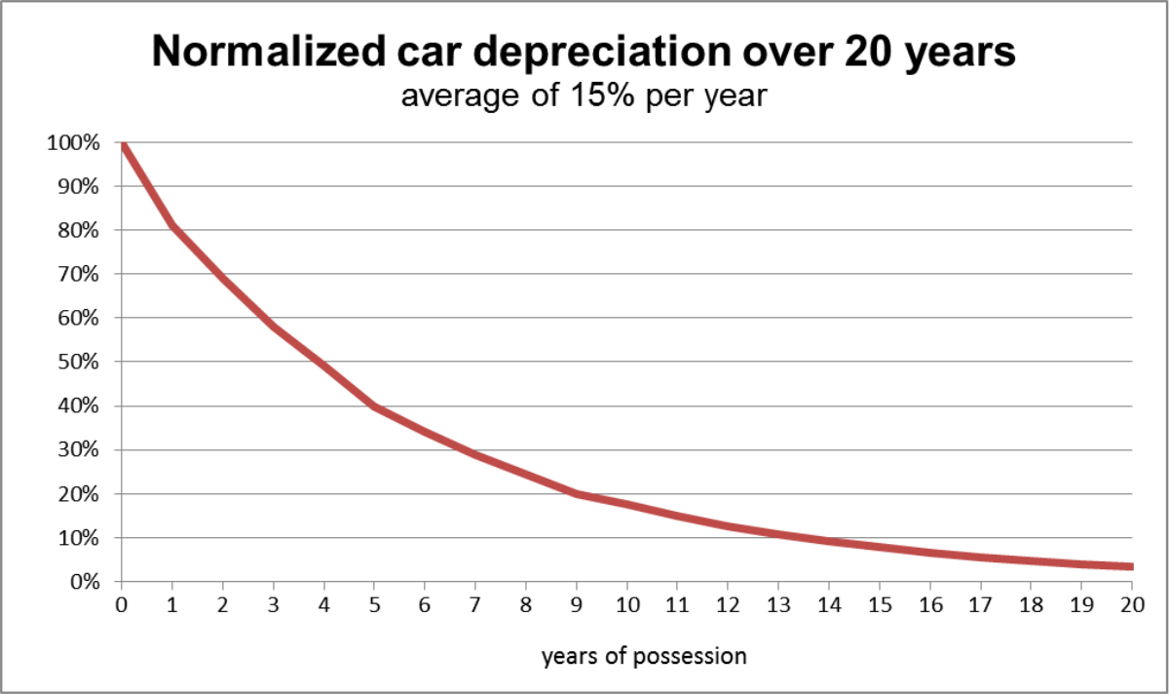
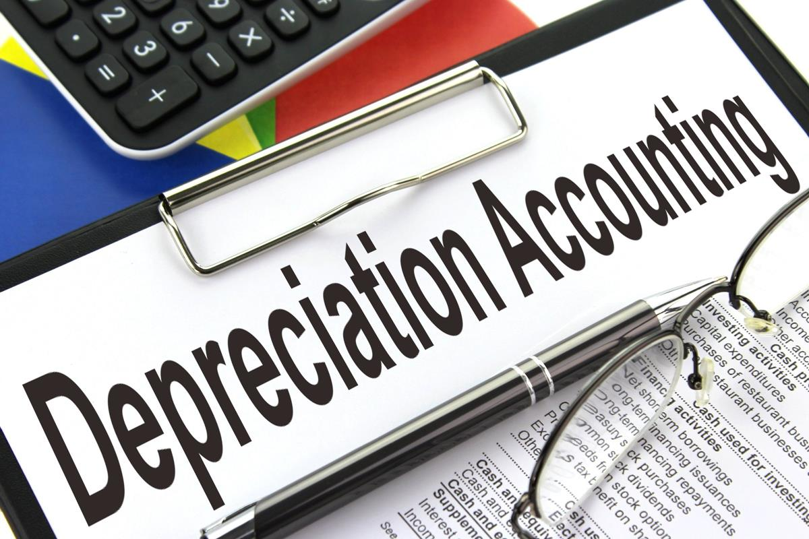
Foundations of Entrepreneurship
Depreciation and Amortization
Manoj K Mondal
RMSoEE, IIT Kgaragpur

Slide 2
Depreciation definition
Methods of depreciation
Amortization
Treatment of Capital Gain or Loss from Sale of Fixed Asset

Slide 3
Depreciation
Depreciation is an accounting method of gradual apportioning of the cost incurred to acquire a tangible asset as expense over its useful life.
Businesses depreciate long-term assets differently for two different accounting purposes: i. for tax and ii. for reporting to stakeholders.

Slide 4
Suppose you buy a Xerox machine for ₹1,00,000.
You estimate that you can make 5,00,000 copies.
Your tonner cost is ₹0.30p a piece.
You pay total labor cost of ₹ 50,000.
You feel that you can charge customers at 0.60p per copy.
You want to estimate your cost and profit.
Your total income out of the Xerox machine in its life of five years.

Slide 5
 | @ 0.60 per page |  | @ 0.50 per page
Total income | 5,00,000 X ₹0.60 | ₹ 3,00,000 | ₹ 5,00,000 X 0.50 | ₹ 2,50,000
Toner cost | 5,00,000 X ₹0.20 | ₹ 1,00,000 | ₹ 5,00,000 X 0.20 | ₹ 1,00,000
Paper cost | 5,00,000 X ₹0.10 | ₹ 50,000 | ₹ 5,00,000 X 0.10 | ₹ 50,000
Labor cost |  | ₹ 60,000 |  | ₹ 60,000
Electricity cost |  | ₹ 6,000 |  | ₹ 6,000
Rent |  | ₹ 24,000 |  | ₹ 24,000
Maintenance |  | ₹ 10,000 |  | ₹ 10,000
Total cost |  | ₹ 2,50,000 |  | ₹ 2,50,000
Profit | 3,00,000 – (1,50,000 + 50,000) | ₹ 50,000 |  | 0.00
Suppose you want to sell the Xerox machine after the first year of operation. You may receive |  | ₹ 70,000 |  | ₹ 70,000
Loss of value of the machine |  | ₹ 30,000 |  | ₹ 30,000
Actual profit |  | ₹ 20,000 |  | (-) ₹ 30,000

Slide 6
Depreciation is the process of charging the loss of value of capital assets in Profit & Loss A/C
Through depreciation, the procurement costs of capital assets are gradually charged in the profit & loss account.
The other alternative is to charge the entire cost of acquisition as expense in the year the expenditure is incurred.
But that would cause great volatility in the bottom-line (profit), which is not desirable.

Slide 7
Methods of Depreciation
Straight-line method
Declining balance method or declining/reducing value method
Sum of years digits
Units of production

Slide 8
Straight-Line Method
In ‘Straight-Line Method’ an asset is evenly depreciated over its useful life.
Same amount of depreciation for a particular asset is allocated as expense each year of useful life.
But, the asset will face some value at the end of assumed life. This is known as ‘Salvage Value’ or ‘Terminal Value’
Therefore, what you need to recover as depreciation is ‘the cost of the machine’ LESS the ‘Salvage Value’.

Slide 9
Straight-Line Method
Depreciation = (Procurement cost – Salvage value)/Useful life
Procurement cost is the money paid to buy the asset.
Salvage value is the likely money to be recovered by selling the asset after the end of its useful life.
Suppose you buy an asset for ₹10,000 in 2016.
You make a fair assessment that the asset will last for five years.
You also assess that after five years, you are likely to sell the old asset at ₹ 2,000.
Here, the useful life is 5 years and salvage value is ₹ 2000
Annual depreciation = (10,000 – 2,000)/5 = 1600

Slide 10
Straight-Line Method … cont’d
Notice that depreciation is the same in all the years of useful life

Slide 11
Book Value
Get the initial cost of the fixed asset.
Subtract the estimated salvage value from the cost.
Estimate the useful life of the asset purely based on judgement.
Divide 2 by 3 to get annual equal depreciation.
Book value of an asset is the cost minus accumulated depreciation.
Book value at the time of purchase is the cost of the asset. At the end of one year, the book value is 10,000 – 1600 = 8,400, after 2 years it is 10,000 – 2X1600 = 6,800, and so on. Accumulated depreciation at the end of 2 years is 2X1600 = 3,200.
1|
2|
3|
4|
5|
6|

Slide 12
Straight-Line Method
Book value is also called the carrying amount of a fixed asset

Slide 13
Declining Balance Method or Reducing Value Method
Also known as ‘Written-down Value Method’
Depreciation is charged at a fixed percentage on the book value of the asset every year.
Procurement cost: ₹10,000. Depreciation rate = 20%
Depreciation during year 1 = ₹10,000X20% = ₹2,000
Book value of the asset at the end of year 1 = ₹10,000 – ₹2,000 = ₹8,000
Depreciation in 2nd year = ₹8,000 X 20% = ₹1,600
Book value at the end of 2nd year = ₹8,000 – ₹1,600 = ₹6,400

Slide 14
Declining Balance Method
Book value is also referred to as ‘Written-down value’

Slide 15
Book Value
Get the initial cost of the fixed asset.
Decide on the percentage of depreciation to be used.
Estimate first year depreciation as the percentage to the cost of the asset.
Estimate the book value as at the end of the first year by subtracting depreciation from the cost.
Estimate the depreciation for the second year as the percentage of the book value as at the end of the fist year, and so on.
Notice the accumulated depreciation in the previous slide.

Slide 16
Compare the Two Methods

Slide 17
The Distinctions Between the Two
Straight-Line Method | Fixed AMOUNT of depreciation is allocated as expense every year | Have to determine useful life of the asset | Salvage is estimated and is deducted from the cost.
Declining Balance Method | Fixed PERCENTAGE of depreciation is allocated as expense each year. | The asset is considered to have perpetual life. | No salvage value concept.

Slide 18
The depreciation amount is recorded as expense in the Profit & Loss statement.
The Value of the asset after depreciation is recorded in the Balance Sheet as the value of the asset and is the book value.
Book value is also referred to as the Net Asset Value or simply Net Value of the asset.

Slide 19
Part of P&L Statement
Part of Balance Sheet Account
Depreciation

Slide 20
Amortization
Amortization is analogous to depreciation.
The difference is that
depreciation is a method of gradual apportionment of the cost of acquisition of capital assets (fixed assets) and gradually charge the cost as expense in profit & loss account.
Whereas,
Amortization is gradual spreading out of cost of acquisition or cost of creation of intangible assets such as R&D cost and brand building cost, some special types of revenue expenses (such as preliminary & preoperative expenses), and some long-term debts.

Slide 21
Amortization
Most common amortization:
Advertisement expenses – though incurred in one year, the benefits are enjoyed for many years.
Research & Development cost: the intellectual property emerging out of the R&D activity is enjoyed over a long period of time.
Preliminary & Preoperative expenses: incurred at the early stage of a startup and is usually capitalized. It is amortized over a suitable period.
Some licenses such as telecom, mining lease, bandwidth that are provided for a particular period for a onetime fee.
From the perspective of useful period, these expenses has some appearance of capital assets.

Slide 22
Depletion (of value)
Used in case of natural resources
For example coal and mines, petroleum blocks
Telecom license: value gets depleted by the passage of time since the license is provided for a fixed period of time.

Slide 23
Profit and Loss Statement for Certain Period
1. Sales or Revenue
2. Minus ‘Cost of goods sold’
3. Opening stock plus Purchase during the year = Available stock. Minus ‘Closing stock’ = Cost of goods sold.
4. Gross profit (1 –2)
5. Salaries
6. Depreciation and amortization
7. Other operational expenses
8. Operating profit [4 – (sum of 5 through 7) ]
9. Interest or finance cost
10. Profit before tax (8 – 9)
11. Income Tax. 12. Net profit = 10 – 11. 13. Dividend
14. Retained profit transferred to Balance Sheet (12 – 13)

Slide 24
Owners’ Capital
Initial and subsequent investment made by the owners in the business.
Part of the net profit generated by the business in each year that has been reinvested in the form of retained earnings or reserves & surplus.
Funds raised through various rounds of investment by Business Angel and Venture Capitalists also form part of equity capital.
Balance Sheet
Equity & Liabilities
Equity capital
Authorized capital | 15,00,000
Paid-up capital | 10,00,000
Reserves & Surplus | 12,15,243
Net worth | 22,15,243

Slide 25
Percentage Holding of Founders
Founders’ holdings are the respective percentage of equity shares held by each.
Say, equity of a startup is ₹10,00,000 divided into 1,00,000 shares of ₹10 each.
Number of founders: 3 (let us call them A, B, & C)
Share holding:
A: 20,000; B: 50,000, & C: 30,000 shares.
Holding of A is 20,000/1,00,000 = 20%
Holding of B is 50,000/1,00,000 = 50%
Holding of C is 30,000/1,00,000 = 30%

Slide 26
You raise ₹1.00 crore from an investor in exchange for 20% of equity
Now the equity distribution is as follows
Investor: 20%
Rest 80% is distributed among the founder in the proportion of their existing holding.
A: 20%X0.8 = 16%
B: 50%X0.8 = 40%
C: 30%X0.8 = 24%

Slide 27
Treatment of Capital Gain or Loss on Sale of Fixed Assets in Profit & Loss A/C
Profit & Loss Statement
Operational data for the year 2018-19 and some balance sheet data as on 31.3.2019
Payment of rent | 6,000
Advertisement expense | 3,000
Purchase of equipment | 12,000
Salary | 36,000
Closing stock | 15,400
Transportation expense | 3,600
Maintenance | 2,500
Legal expense | 500
Purchase of goods | 85,000
Construction of factory shed | 300
Purchase of truck | 2,500
Truck hiring charge received | 300
Amortization of Prelem. & preop. | 200
Repayment of bank loan | 1,600
Trade Receivables | 8,100
Telephone bill payment | 350
Purchase of telephone | 20
Electricity bill payment | 1,250
Sale of old machine (book value: 2400) | 2,400
Operational data for the year 2018-19 and some balance sheet data as on 31.3.2019
Payment of rent | 6,000
Advertisement expense | 3,000
Purchase of equipment | 12,000
Salary | 36,000
Closing stock | 15,400
Transportation expense | 3,600
Maintenance | 2,500
Legal expense | 500
Purchase of goods | 85,000
Construction of factory shed | 300
Purchase of truck | 2,500
Truck hiring charge received | 300
Amortization of Prelem. & preop. | 200
Repayment of bank loan | 1,600
Trade Receivables | 8,100
Telephone bill payment | 350
Purchase of telephone | 20
Electricity bill payment | 1,250
Sale of old machine (book value: 2000) | 2,400
Operating expenses | 52,857
Operating profit (OP) | 13,343
Operating profit margin (OP/Sales)X100 | 8.90%
Add profit from sale of fixed assets | 400
Subtract Interest | 1,020
Add other income (Truck hiring charge) | 300
Profit before tax | 13,023

Slide 28
Treatment of Capital Gain or Loss on Sale of Fixed Assets in Profit & Loss A/C
Profit & Loss Statement
Operational data for the year 2018-19 and some balance sheet data as on 31.3.2019
Payment of rent | 6,000
Advertisement expense | 3,000
Purchase of equipment | 12,000
Salary | 36,000
Closing stock | 15,400
Transportation expense | 3,600
Maintenance | 2,500
Legal expense | 500
Purchase of goods | 85,000
Construction of factory shed | 300
Purchase of truck | 2,500
Truck hiring charge received | 300
Amortization of Prelem. & preop. | 200
Repayment of bank loan | 1,600
Trade Receivables | 8,100
Telephone bill payment | 350
Purchase of telephone | 20
Electricity bill payment | 1,250
Sale of old machine (book value: 2400) | 2,400
Operational data for the year 2018-19 and some balance sheet data as on 31.3.2019
Payment of rent | 6,000
Advertisement expense | 3,000
Purchase of equipment | 12,000
Salary | 36,000
Closing stock | 15,400
Transportation expense | 3,600
Maintenance | 2,500
Legal expense | 500
Purchase of goods | 85,000
Construction of factory shed | 300
Purchase of truck | 2,500
Truck hiring charge received | 300
Amortization of Prelem. & preop. | 200
Repayment of bank loan | 1,600
Trade Receivables | 8,100
Telephone bill payment | 350
Purchase of telephone | 20
Electricity bill payment | 1,250
Sale of old machine (book value: 2500) | 2,400
Operating expenses | 52,857
Operating profit (OP) | 13,343
Operating profit margin (OP/Sales)X100 | 8.90%
Subtract loss on sale of fixed assets | 100
Subtract Interest | 1,020
Add other income (Truck hiring charge) | 300
Profit before tax | 12,523

Slide 29
Treatment in cash flow statement
From investment activities
Change in land | 0
Change building | -300
Machinery | -14,520
Sold machine | 2,400
Sub total | -12,420
From operating activities
Net profit | 8836.1
Depreciation & amortization | 2157
Change in inventory/ stock | -1200
Change in accounts receivable | 1000
Change in account payable | 957
Add loss on sale of equipment | +
Subtract gain on sale of equipment | -
Sub total | 11750.1

Slide 30
Treatment of Capital Gain or Loss on Sale of Fixed Assets in Balance Sheet
Non-current assets/ Fixed assets 31.32018 31.3.2019
Land 500 500
Building 1000 1,235
Plant & Machinery 6800 17,028
Preliminary & Preoperative exp. To the extent not amortized 500 300
Total non-current assets 8800 19063
Total assets 34040 51,703

Slide 31
Complete treatments
P&L A/C: only the difference is either added or subtracted
Balance sheet: Book value is deducted
Cash Flow statement:
Loss is added in ‘Cash flow from operating activities’
Profit is deducted from ‘Cash flow from operating activities’
The exact cash receipt is added in Cash Flow from investment activities

Slide 32
Business Model & Business Model Innovation (BMI)
“A business model describes the rationale of how an organization creates, delivers, and captures value, in economic, social, cultural or other contexts. The process of business model construction and modification is also called business model innovation and forms a part of business strategy.” - Wikipedia

Slide 33
Business Model
Business model is core aspect as to how a business creates and profitably delivers value to a group of satisfying customers.
It is imperative that a business creates social, environmental, and cultural values for sustainability in the long run.
Business model includes the purpose, vision, target customers, offerings, the value proposition, organizational structures, business process, infrastructure requirement, values and culture.

Slide 34
Innovation
Innovation is the process of turning new ideas and knowledge into value, in the form of new products, services, or ways of doing things.
It is deceptively complex, and goes beyond mere creativity and invention to include the steps necessary for benefiting people.
Very few innovations are groundbreaking. Majority are value addition to on earlier versions.
Evidently, innovative firms significantly outperform others.
Innovations fuel the majority of the world's long-term productivity and economic growth.

Slide 35
Necessity Is the Mother of All Innovations
If you are wondering which direction new technologies will emerge,
Perhaps the best place to look at is the severest of pains the society is facing or likely to face in the immediate future.
Pipping into research laboratories may not be much help.
Go out and do something. You may encounter problems and start building solutions to that.
Many entrepreneurs built solutions to problems they faced themselves. Phanindra Sama of redBus, Mahendra Pratap of Integra Micro Systems and many more.

Slide 36
Business Model Innovation (BMI)
A business model is a business context explaining how an organization creates and delivers values in economic, social, cultural or other forms.
The process of reconstruction of various aspects of the business for meeting changing market behaviour and delivering increasingly superior value to customers is business model innovation.
Execution of the plan is an integral part of BMI and thus, management is inextricable part of BMI. Management innovation is a continuous process.

Slide 37
When the game gets tough, change the game.
- Belinda Anne Tamayo

Slide 38
Innovation Contexts
Innovation
Technology innovation
Business Model Innovation
Government innovation
Innovation systems
Innovation for social benefits
Source https://intelligence.weforum.org

Slide 39
Technology Innovation – Emerging Areas
Fourth industrial revolution
Biotechnology
3D printing
Virtual and augmented reality
Artificial Intelligence & Robotics
Human enhancement
Advanced materials
5G
Internet of things
Autonomous transportation
Digital communication
Blockchain
Quantum computing

Slide 40
Business Model Innovation: Industrial Revolution - 4.0
Disrupts status quo to provide better comforts to people or alleviate pain.
The future of economic progress
Shape corporate governance
Next generation information technology
Will promote new multinationals

Slide 41
Is Technology Innovation Different from BMI?
All technology innovations are part of BMI
Some BMIs are through technology innovation

Slide 42
“Get the business model wrong and there is no business” – Prof. David Teece, University of California, Burckley
The What, Why, How, and Whom of BMI
⬥
⬥
⬥
⬥
What – What innovations are you executing?
Why to innovate business model – will it create more value to your customers and bring advantages to your organization?
How – how are you going to create and deliver economic, social, cultural and environmental values?
For whom – Whose problems are you aiming alleviate?

Slide 43
Business Model Innovators Outperform Competition in Terms of Operating Margin, Shareholders’ Return

Slide 44
Business Model Innovation is Possible in Several Forms
Value Proposition | The product as service and outcome General Electric SaaS | The products as an experience Apple – iPod Candle with aroma | Trust premium Whole Foods TATA | Free (or nearly free)/ Freemium Google Gaana Spotify
Operating Model | Deconstruction Li & Fung Ltd. Adani | Integration/ acceleration of the supply chain Zara Reliance | Low cost Aravind Tata Motors | Direct distribution Google CCD Nestle Nespresso
Business System Architecture | Open Facebook | Person to person PayPal PayTM | Adjacency Ikea’s Mega Mall Division | Serial Virgin Group
Recreated from BCG Research

Slide 45
Financial Accounting: A Managerial Perspective by R. Narayanaswamy
Tulsian’s Principles and Practice of Accounting for CA Foundation Course with Quick Revision Book
by P. C. Tulsian, Bharat Tulsian
Financial Management for CA Intermediate by V. Rajesh Kumar
Some references unrelated to the above topic
http://benbarry.com/project/facebooks-little-red-book
Stel A. v, M. Carree and R. Thurik (2005), The effect of entrepreneurial activity on national economic growth, Small Business Economics, Vol. 24, No. 3, pp. 311-321
Praag C. M. Van, and P. H. Versloot (2007), What is the value of entrepreneurship? A review of recent research, Small Business Economics, Vol. 29, pp. 351–382
Rajiv Shah, Zhijie Gao, Harini Mittal (2015) Innovation, Entrepreneurship, and the Economy in the US, China, and India – Elsevier
Sean Ammirati (2016) The Science of Growth: How Facebook Beat Friendster—and How Nine Other Startups Left the Rest in the Dust, St. Martin’s Press.

Slide 46
Good Video Lectures and Reading Materials
http://startupclass.samaltman.com/
http://darwine.nl/weblog/files/Stanford-How_to_Start_a_Startup.pdf

Slide 47
Straight-line method is the default method of depreciation.
Depreciation is non-cash expense.
Depreciation and amortization is mere book entries to charge these costs in the profit & loss account.

Slide 48
Thank you

